Slide 1

Transmitting
Data From Space
Kaitlin Puryear

Slide 2
Overview
Case Studies:
Jupiter: Juno
Mars: Spirit and Opportunity
Future Advances

Slide 3
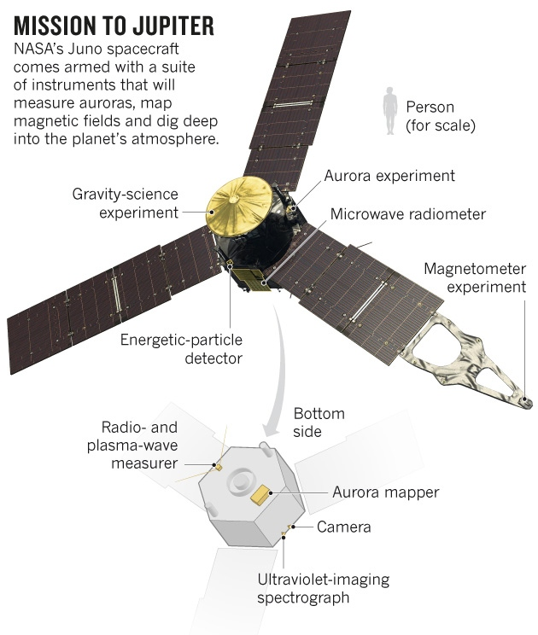
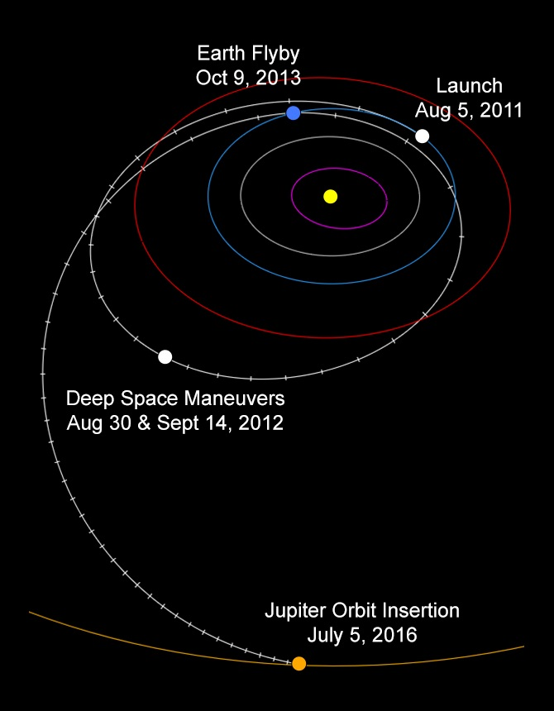
Juno Spacecraft
Launched:
August 5, 2011
Entered Jupiter’s gravity:
July 5, 2017
Payload:
9 science instruments
Mission Objectives:
- Determine H and O content
- Measure mass of core
- Map gravitational and magnetic fields

Slide 4
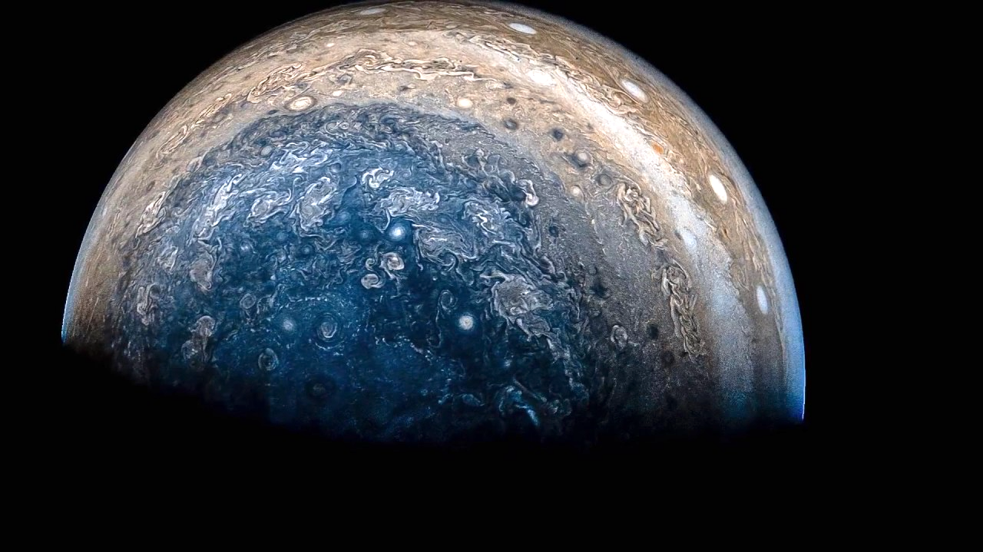
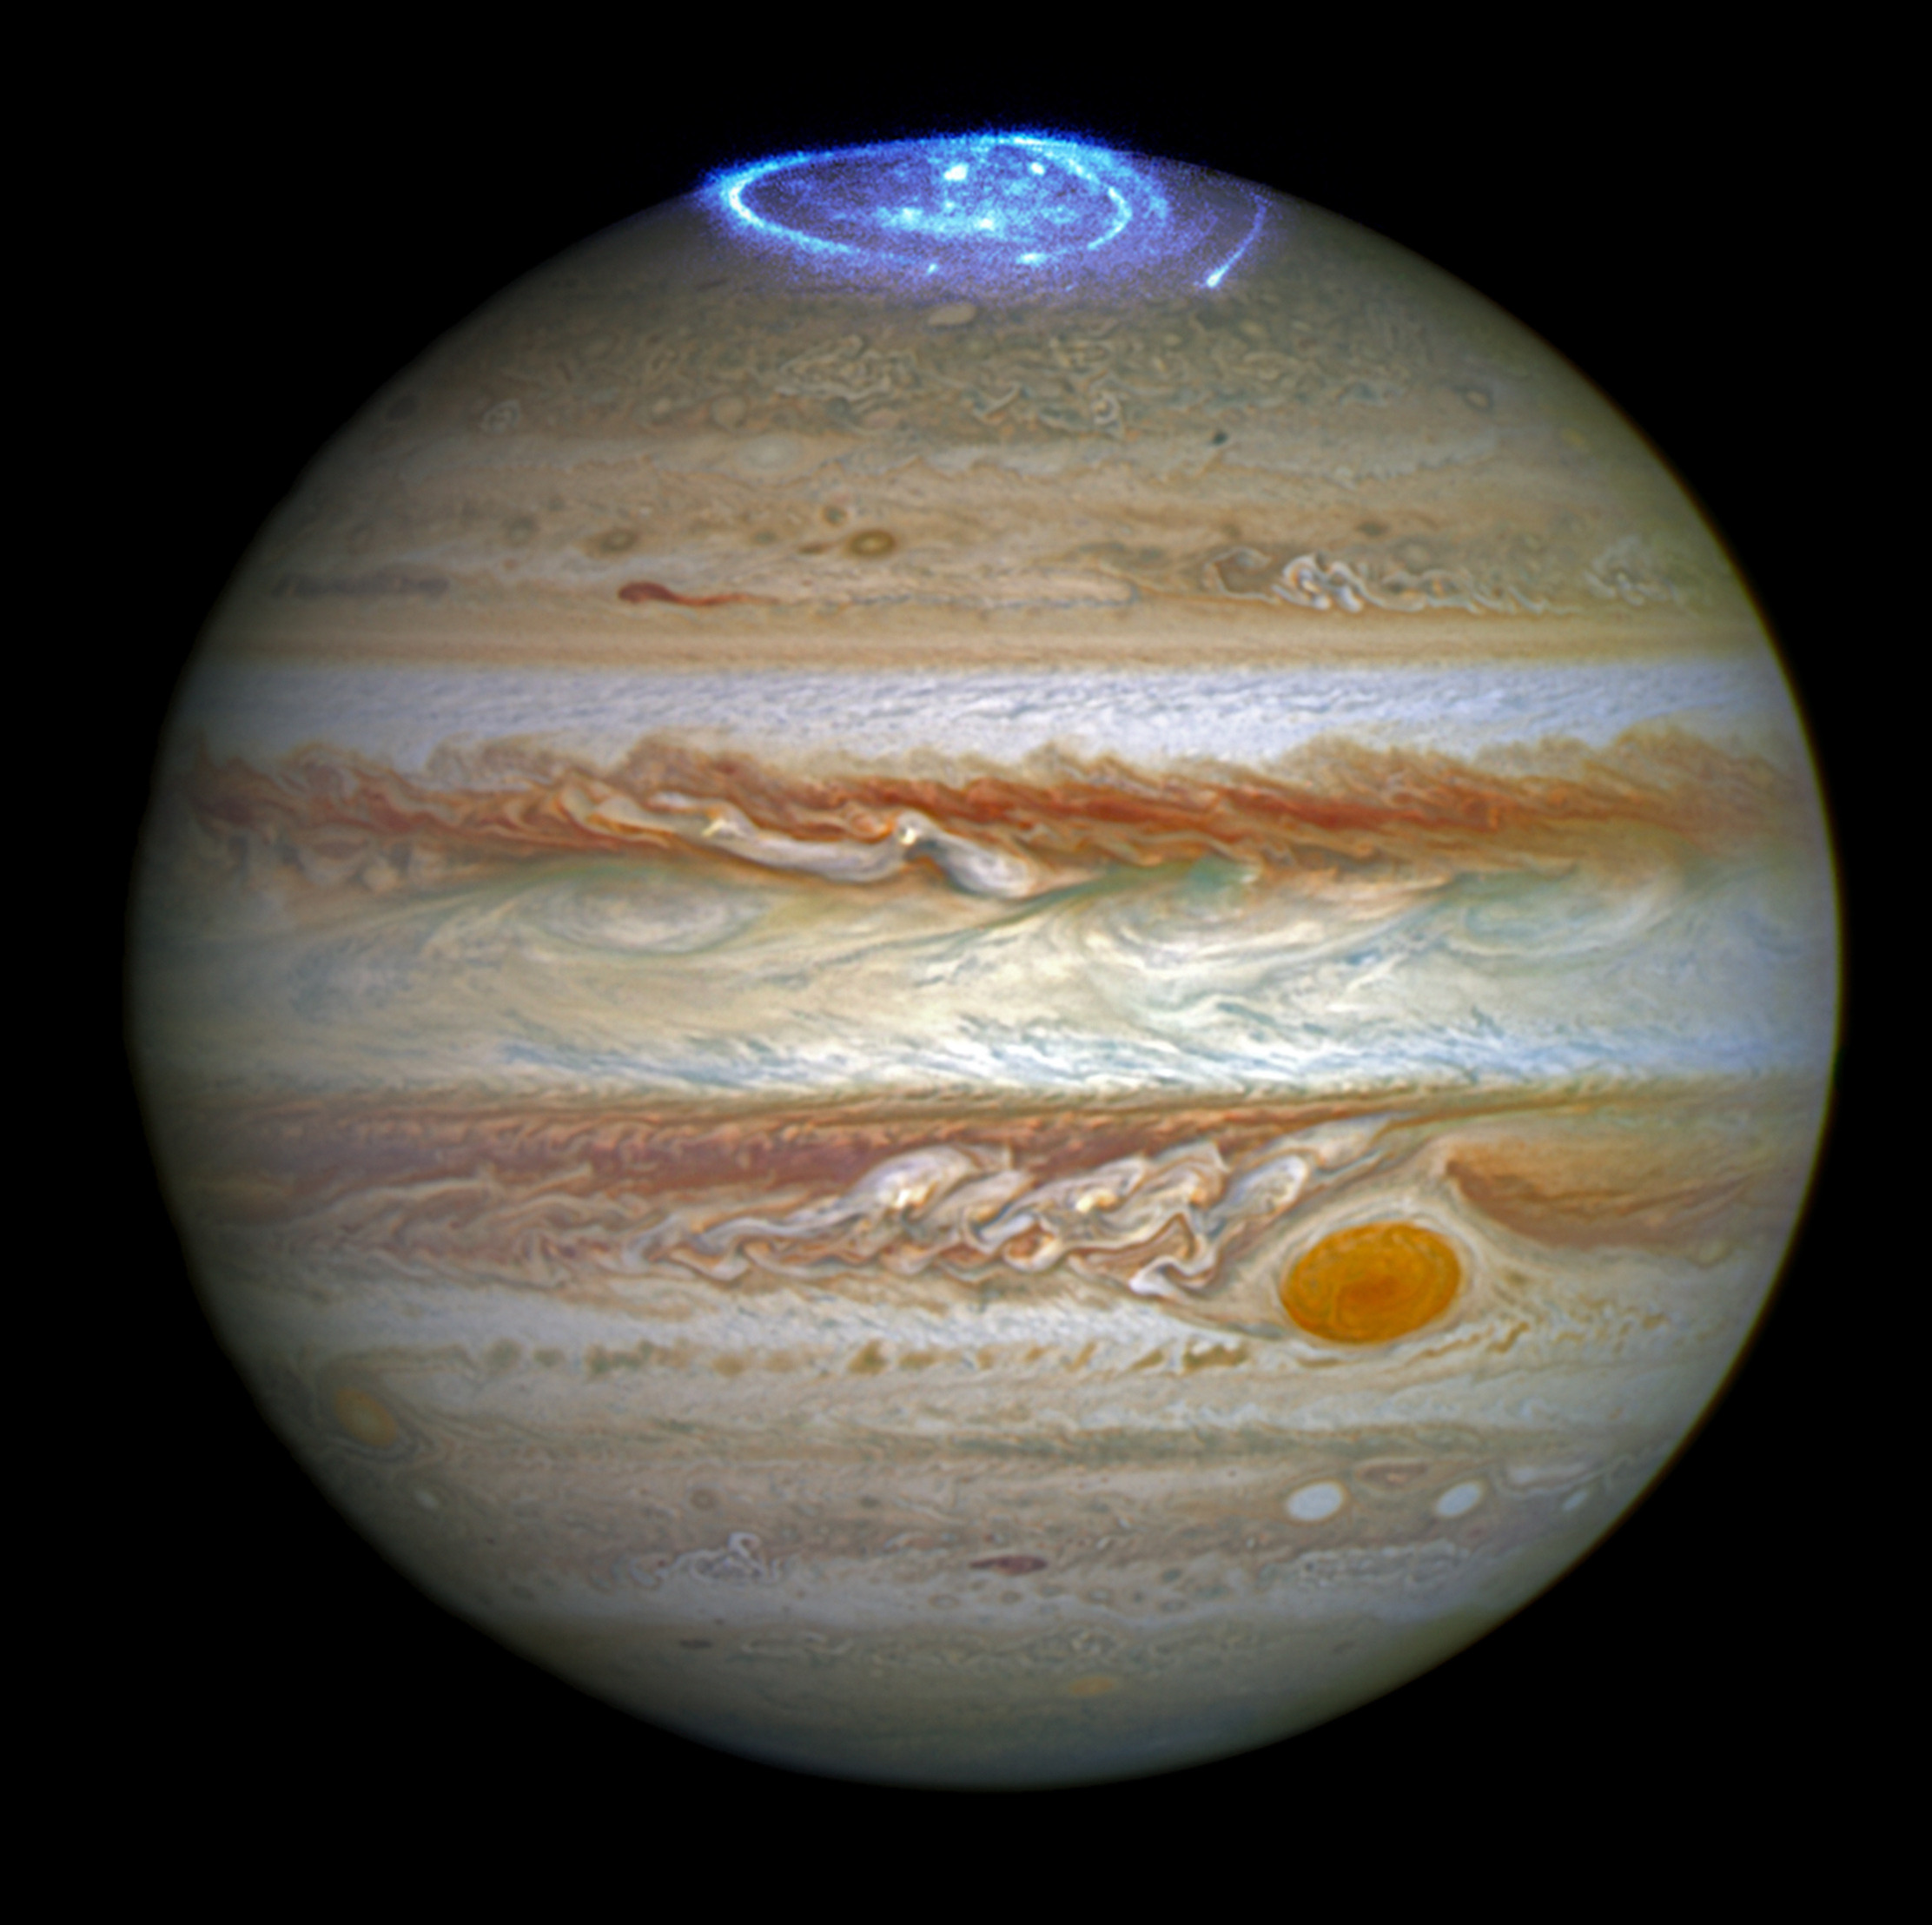
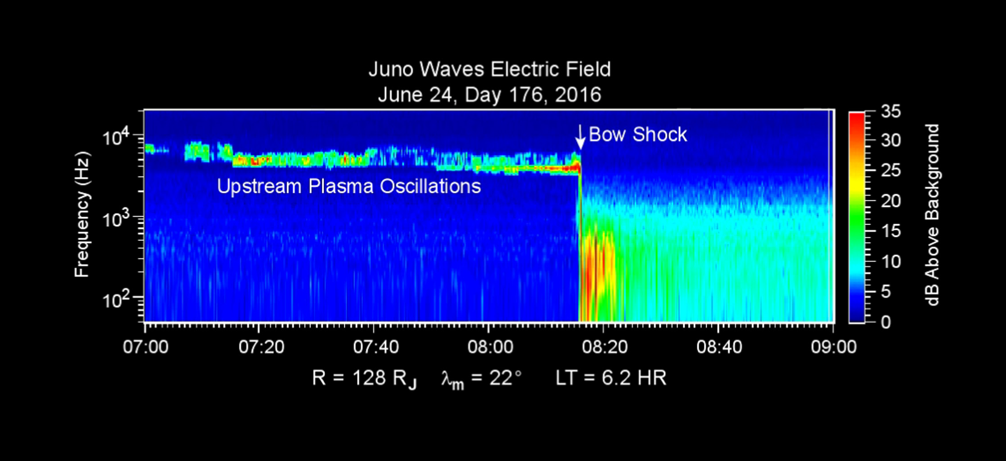
Juno
Science Data

Slide 5
Data Storage on Juno
On-board data storage capacity is a very limited resource.
4 gigabytes of storage.
General laptop RAM = 8 gigabytes.
Nine instruments collecting data simultaneously
Radio and Plasma wave analysis: 2 instruments together have been allocated just 2 gigabits (!!) of storage
Gigabits, not gigabytes!

Slide 6
Transmitting Jovian Data from Juno
Juno doesn’t have to store that data forever.
During Jovian close-up, space craft swings close to Jupiter:
Juno’s scientific instruments will start going through cycles of bingeing and purging, gobbling up information
Sends information back to Earth via the Deep Space Network during the rest of the orbit.
X band wavelength

Slide 7
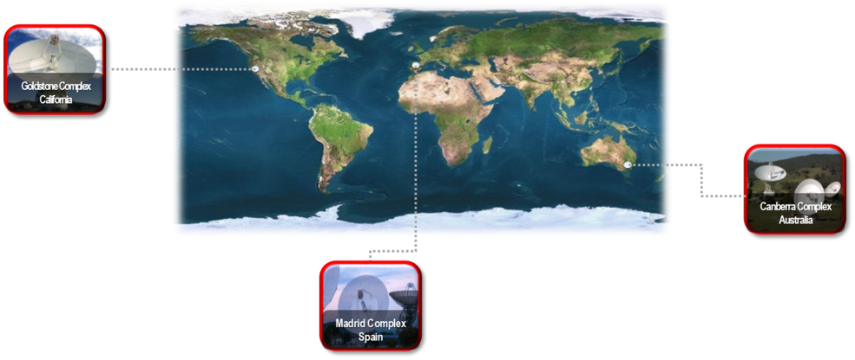
Deep Space Network

Slide 8
Deep Space Network
Deep Space Network Maximum data transfer rate:
25 kilobytes/sec
USB 3.0 connector data transfer rate:
600,000+ kilobytes/sec

Slide 9
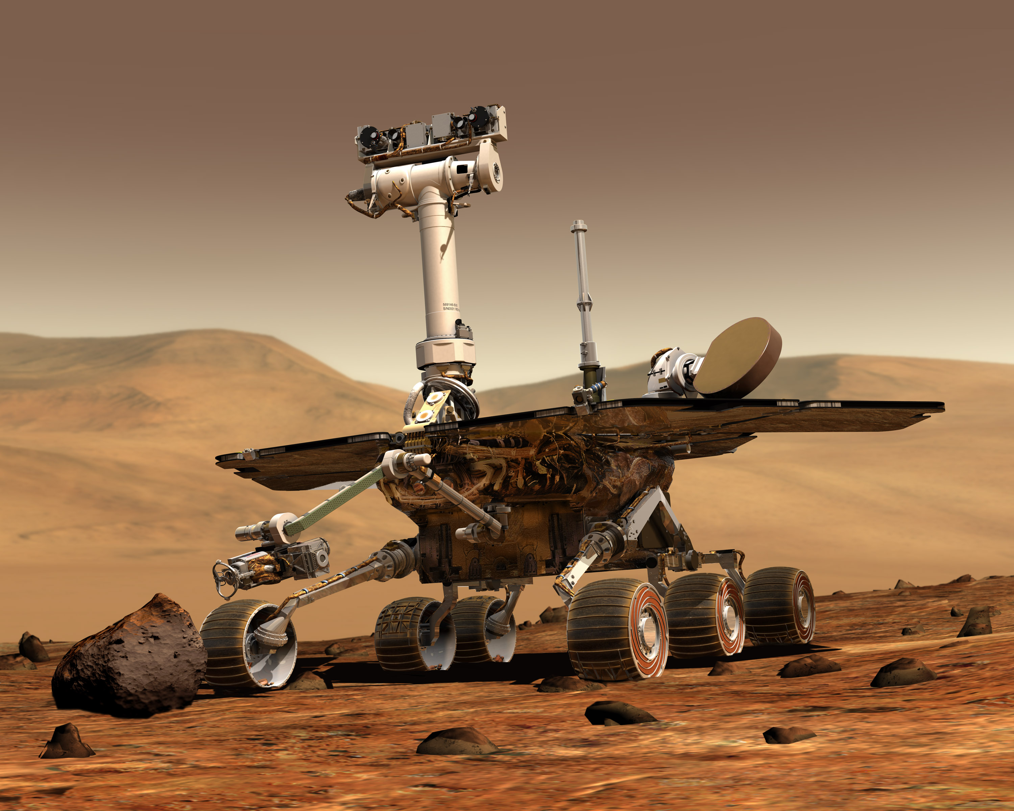
Spirit &
Opportunity
Mars Rovers
Launched:
Spirit – June 10, 2003
Opportunity – July 7, 2003
Powered Off:
Spirit – May 25, 2011
Opportunity – STILL GOIN’ STRONG
Mission Objective:
search for and characterize a wide range of rocks and soils that hold clues to past water activity on Mars.

Slide 10
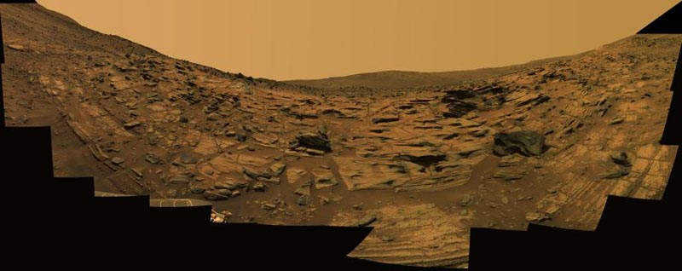
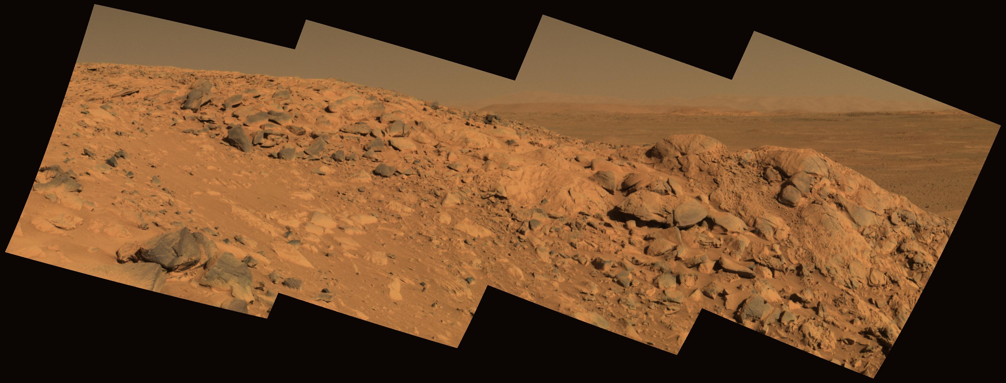
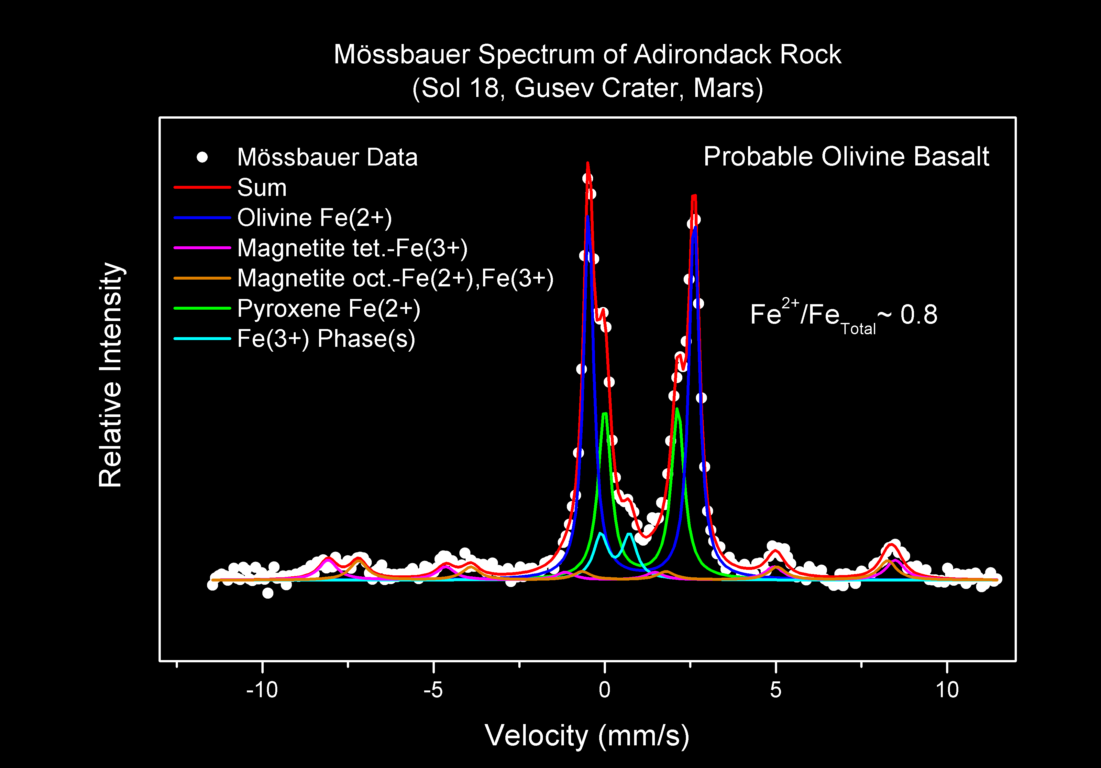
Spirit &
Opportunity
Science Data

Slide 11
Transmitting Martian Data
Spirit and Opportunity use X Band Microwave-Radio Frequencies to communicate with Earth
(Think Radio Stations)
Frequency range of the X band is (arbitrarily) set at approximately 7.0 to 11.2 GHz

Slide 12
Transmitting Martian Data
In December 2014, NASA reported that Opportunity was suffering from “amnesia” events
in which the rover fails to write data, e.g. telemetry information, to non-volatile memory.
Believed to be due to an age-related fault
The rover was configured to operate in RAM-only mode, completely avoiding the use of non-volatile memory for storage

Slide 13
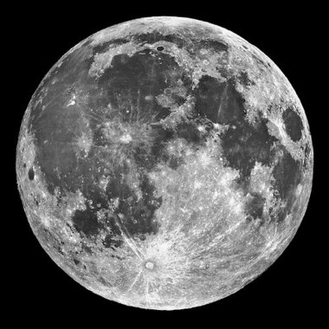
What’s next?

Slide 14
Moon-Mobile Network
Article published Feb 27, 2018 in BBC News
Vodafone and Nokia have laid out plans to launch a 4G mobile Network on the Moon by 2019
Lunar rovers will communicate information to a Lunar Base which will use the 4G network to transmit back to Earth
http://www.bbc.com/news/av/technology-43211192/moon-to-get-4g-mobile-network

